Slide 1
Algorithmic and High-Frequency Trading Algorithmic Trading Strategies
Ken Liu

Slide 2






My Background
Study Computer Science
iBanks Algo trade technologist
Startup on Quant Trading, Big Data and AI
Email: wkliu_x@yahoo.com
LinkedIn: https://www.linkedin.com/in/ken-liu-76b11575/

Slide 3

My Work
Sub-header/text/chart/table

Slide 4
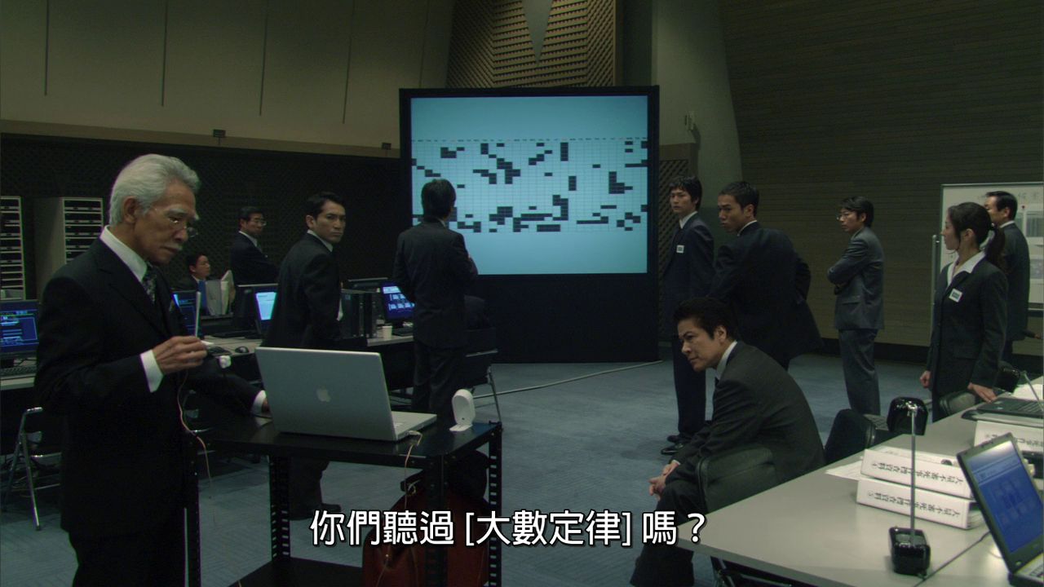
My Work
Sub-header/text/chart/table

Slide 5
Course Content
Background and financial industry practice
Algo Trading Strategies
Big and Alternative Data
AI and Machine Learning
Sentiment Analysis and NLP (Natural Language Processing)
Reinforcement Learning on Trading
Challenges of AI in Trading

Slide 6
Approach
Interactive
Feedback & Discussions & Sharing & Have fun
Class Website
Code examples via Google Colab (cloud-based programming)
Industry Experience Sharing
Electronic Trading Desk
Algo Trading Strategies
How big firms trade stocks
Big Data and AI Startup Experience Sharing
Workflow on research and trading
Challenges in building profitable AI quant trading models

Slide 7
Assessment
Continuous Assessment (20%): In-class exercises and discussions
Group Presentation (40%): group presentation demonstrating the usage of Machine Learning in Algorithmic trading
Exam (40%): Written exam

Slide 8
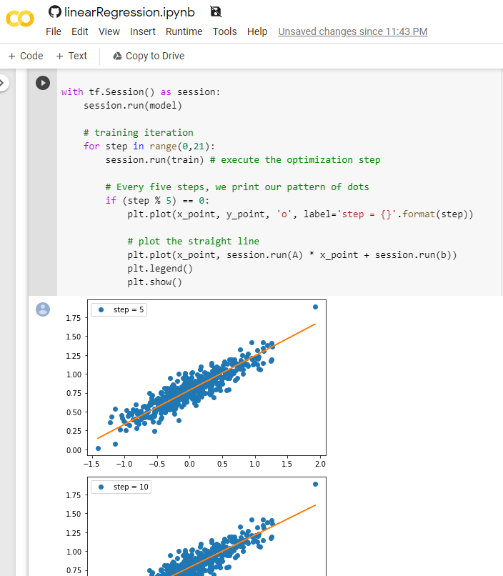
Google Colab
https://colab.research.google.com
Coding on the cloud anytime anywhere
Interactive Python/Jupyter
Pre-installed libraries and can install your own
Is a full-blown machine with GPUs
Can be shared with others

Slide 9
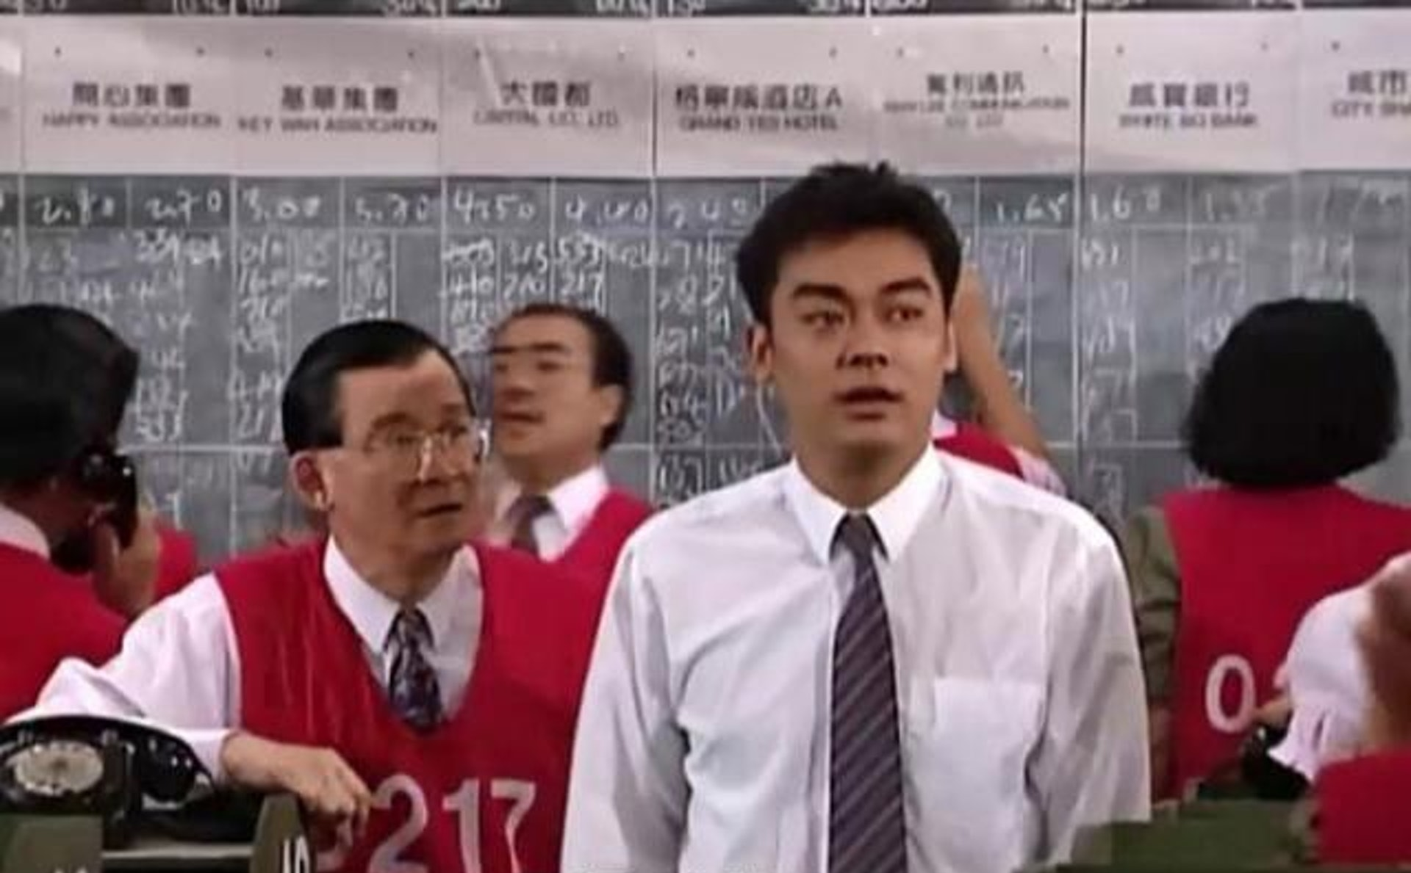
History of trading

Slide 10
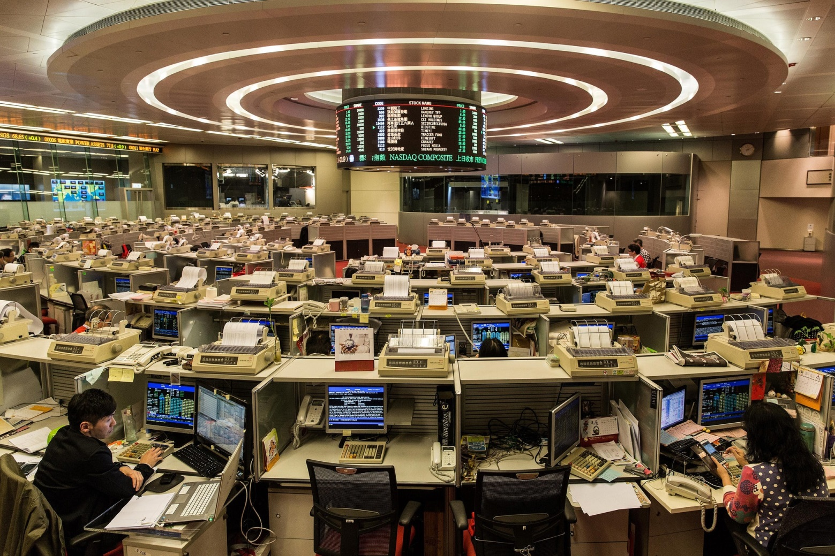
History of trading
2 April 1986 | First day of trading in the Hall
1 November 1993 | Electronic trading introduced
25 January 1996 | Off-floor trading introduced
23 October 2000 | Online trading enabled
27 October 2017 | Last day of trading in the Hall

Slide 11
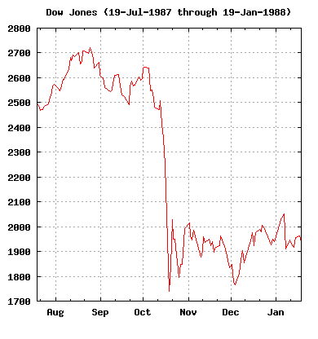
Major Event: 1987-10-19 Black Monday
DJIA fell exactly 508 points to 1,738.74 (22.61%)
Many blamed program trading strategies for blindly selling stocks as markets fell, exacerbating the decline

Slide 12
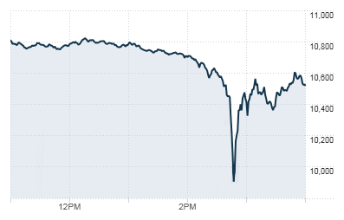
Major Event: 2010-05-06 Flash Crash
Equity market dropping 600 points in 5 minutes
20 minutes later, market had regained most of the 600-point drop
Spoofing, Layering and front-running were banned by 2015

Slide 13
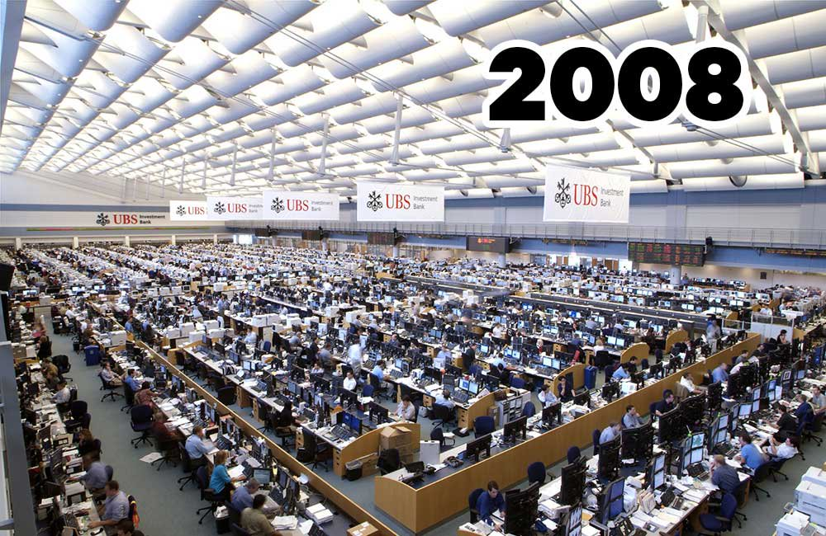
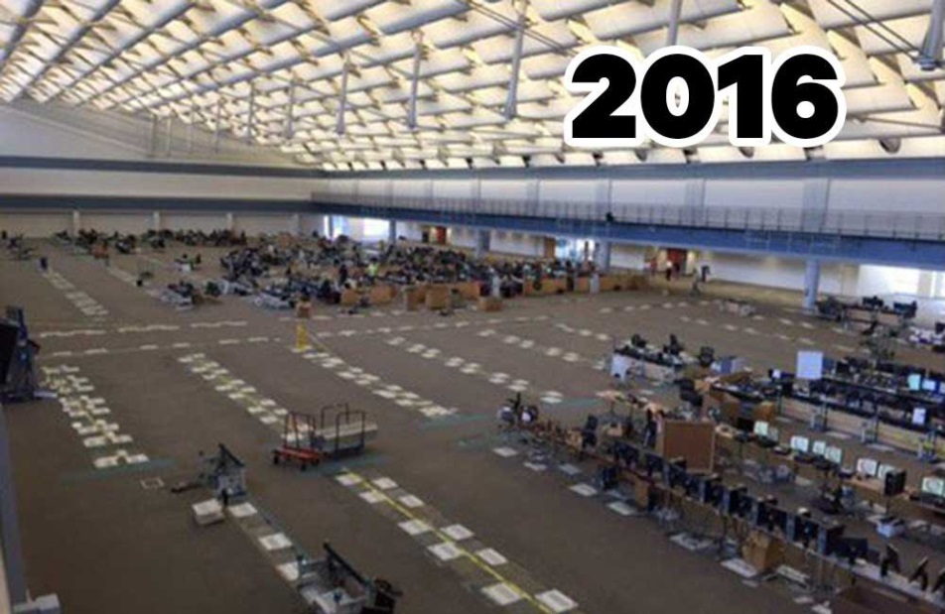
Industrial Practice – Biz
Main Drivers
Lower cost, less man power, speed and reduce error (in most circumstances)
8 Dealers for HK market -> 2 Dealer for APAC market
Traders becomes Sales Trading and Execution Consultants
Notes:
Before earn $10 share $5, now earn $10 but share only $1

Slide 14
Industrial Practice – Biz
Trading Desk
High Touch - Single Shares, Program Flow
Low Touch - DMA (Direct Market Access), DSA (Direct Strategy Access)
Prop Desk – Proprietary trading and take P&L on positions
Flow
Agency - (Client, Client Facilitation)
Risk - (Proprietary, Firm/House, Client Facilitation)
Compliance and Regulator
Algo documentation, training, testing and audit, Dark Pool License
Notes:
Before earn $10 share $5, now earn $10 but share only $1

Slide 15
Industrial Practice – Players
Buy Side
Hedge funds, HFT, Proprietary Trading: Renaissance Tech, DE Shaw, AQR
Asset Management: BlockRock, Citadel
Sell Side
Agency Brokers: ITG, Instinet
Investment banks: Goldman Sachs, Citi, Credit Suisse
Algo Vendors
Fidessa (Selling systems and services on the cloud)
Trading Networks
Liquidnet
Notes:
Before earn $10 share $5, now earn $10 but share only $1

Slide 16
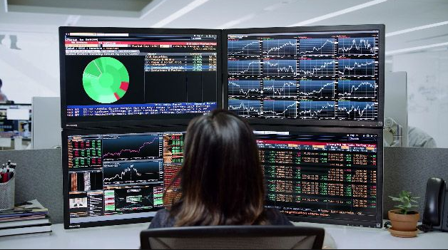
Industrial Practice – Players
Market Data Vendors : Reuters, Bloomberg
Notes:
Before earn $10 share $5, now earn $10 but share only $1

Slide 17
Type of Algos
Agency Execution Algos (for commissions):
Break down large order for controlled market impact (e.g VWAP)
Prevent Information leakage (e.g. Stealth, Iceberg)
Portfolio / Proprietary / Risk Algos (for PnL):
Identify the investment or market opportunities (e.g. Market Making, Index/Statistical Arbitrage, Trend Following, Equities Long/Short, Macro)
High Frequency Trading (for PnL)
Latency and Venue Arbitrage
Notes:
Before earn $10 share $5, now earn $10 but share only $1

Slide 18
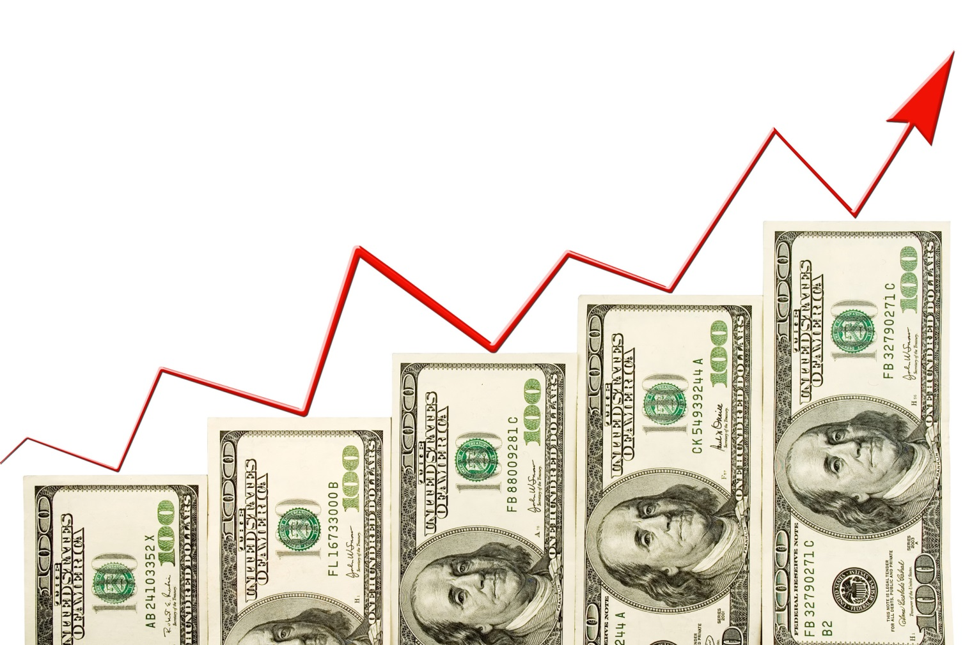
Trading Strategies – Prop Trading
Trading for the money
If I told you I would have to kill you… (if the strategies really works !)

Slide 19
Trading Strategies – Prop Trading
Prop Trading: 3 tech guys startup
Funding: P&L on our own $
Markets: HK
Strategies: Day-trading
Systems: Fully automated trading systems
Long Term Vision: AI funds

Slide 20
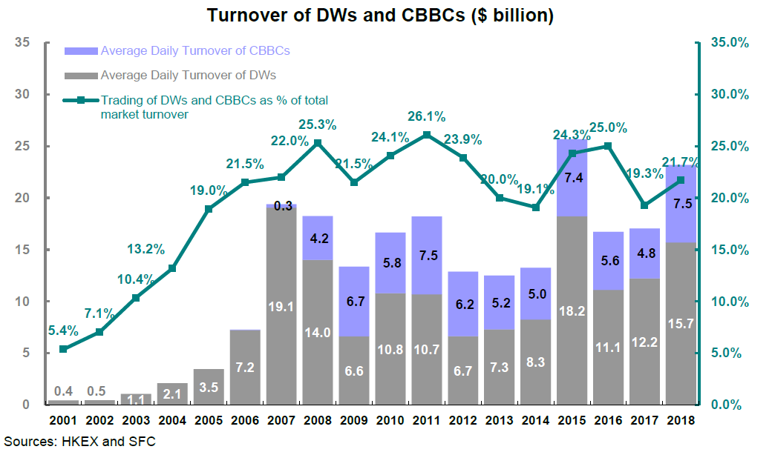
Trading Strategies – HK Warrant
Has enough liquidity and volatile enough for day trading
Back by big issuers (investment banks)

Slide 21
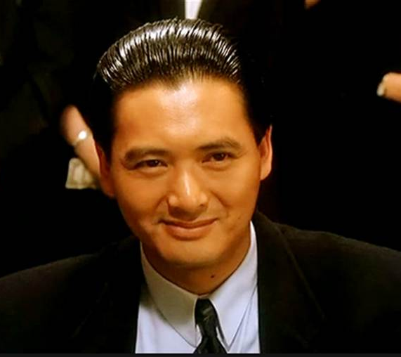
Trading Strategies – HK Warrant
Objective: Try to follow a “super trader” (aka God of Gambler 賭神) and profit from it. Similar to Social Trading / Trending Following

Slide 22

Trading Strategies – HK Warrant
Enter Trade when "super user" trade (when a single trade of notation greater than certain amount on a warrant and ask price move up (>= 1 tick) within 10ms to 5s
Exit Trade in these 3 modes
1: Profit mode: Sell if bid + 2 ticks >= avg px
2: Stop Loss: avg px - bid >= 3 ticks
3: Time mode: 15 mins before market close
Canberra Blackjack Experience for the 3 ticks stop loss

Slide 23
Trading Strategies – HK Warrant
Possible enhancements:
Enter Trade: Look at more factors such the warrant implied volatility, market index, stocks and options movement etc.
Exit Trade: Improve profit mode (let the ball rolling) by predicting short term movement from the order book imbalance and money flow
Betting Size: Rather than placing same size or notional each time, optimizing the betting size for each trade…

Slide 24
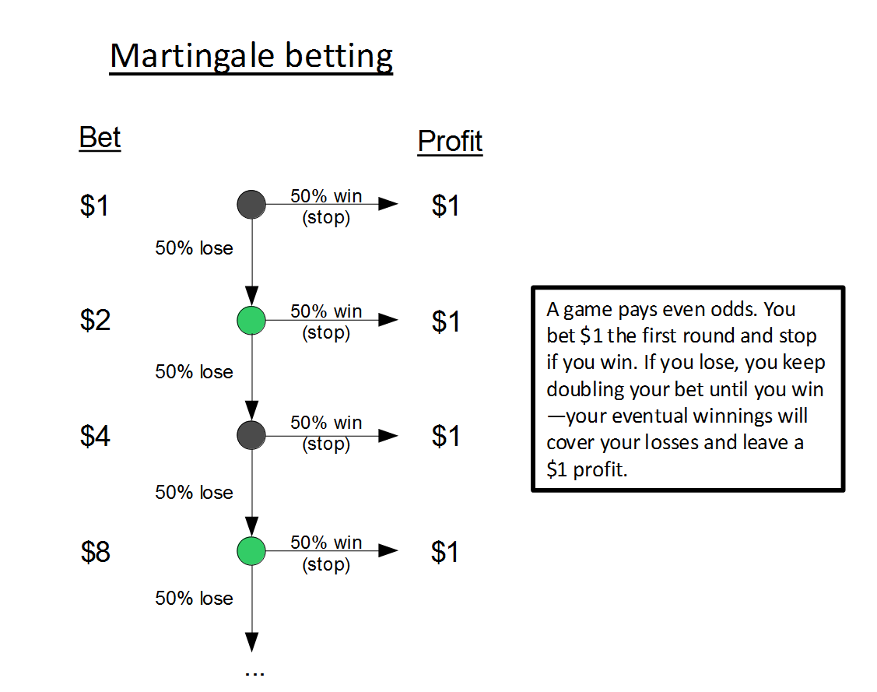
Trading Strategies – HK Warrant

Slide 25
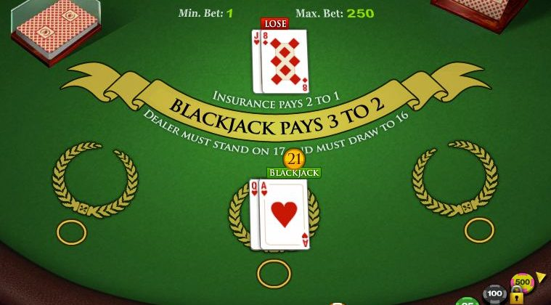
Trading Strategies – HK Warrant
Kelly Bet: is a formula for bet sizing that leads almost surely to higher wealth compared to any other strategy in the long run

Slide 26
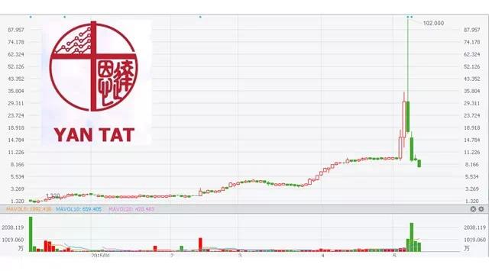
Trading Strategies – HK Small Caps
Objective: Track abnormal movements for small caps HK names

Slide 27
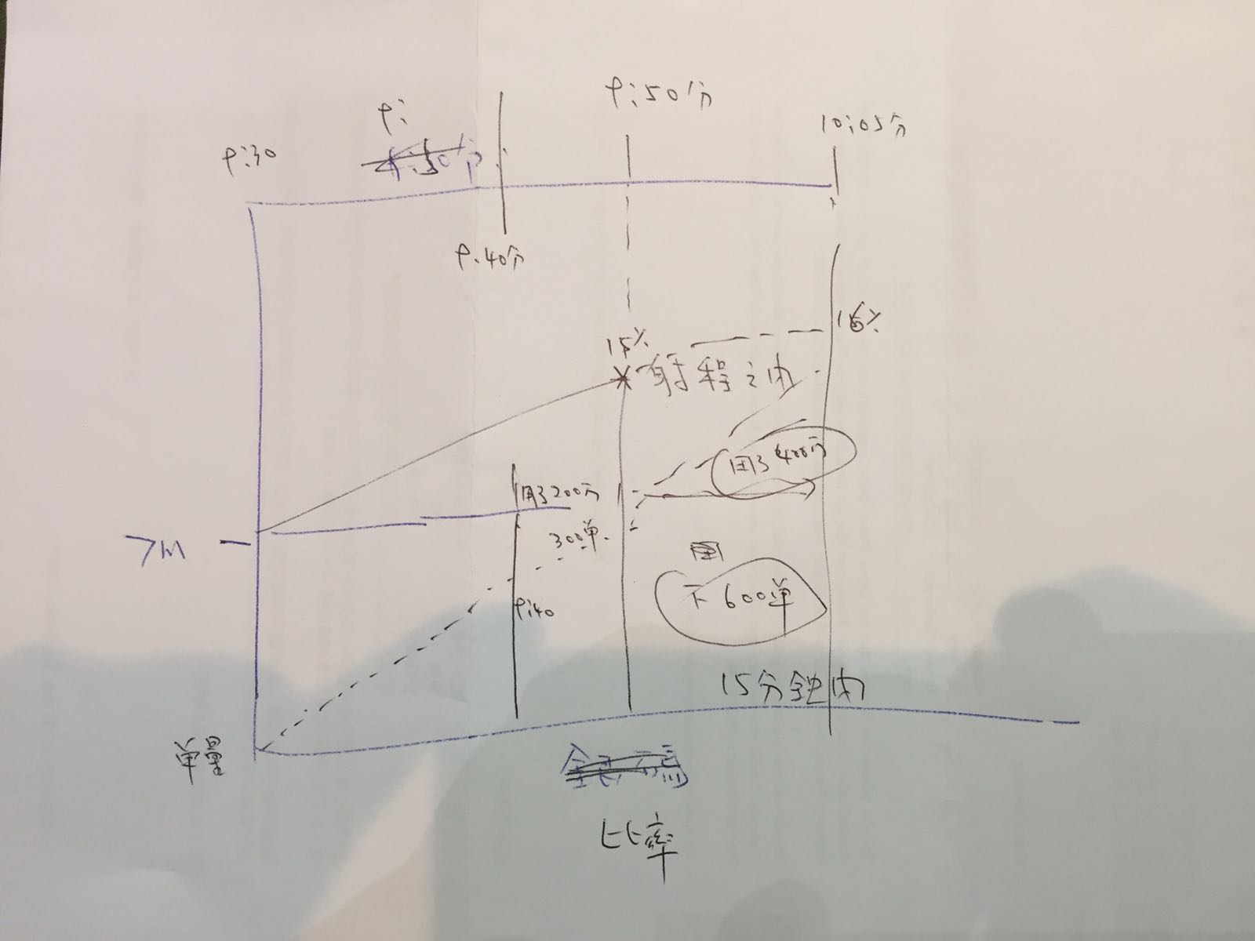
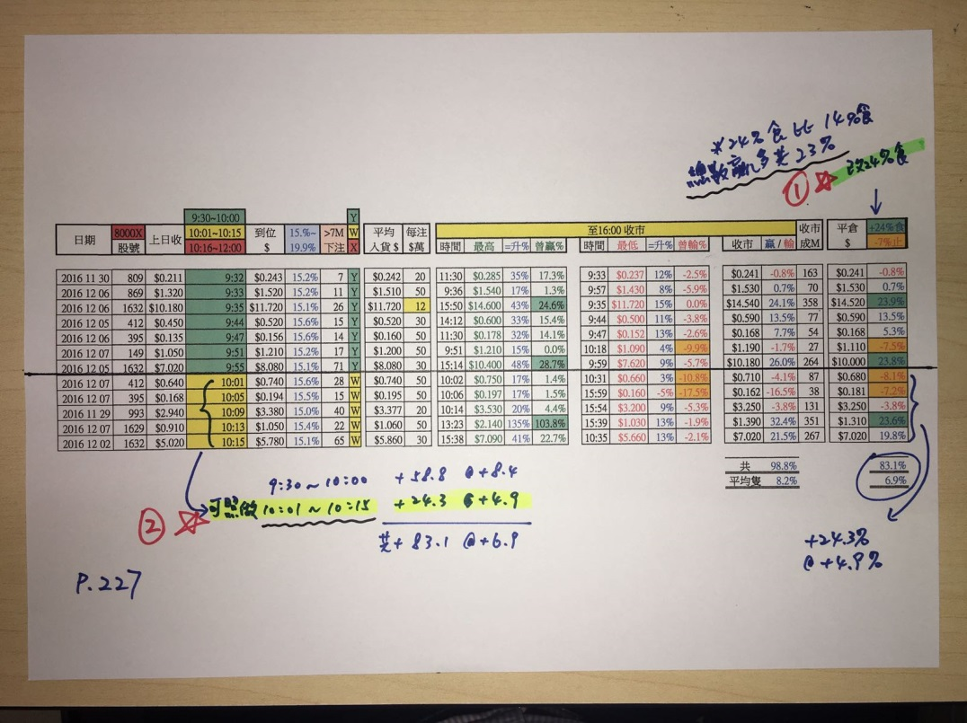
Trading Strategies – HK Small Caps
Criteria:
Daily movement > 10%
Market cap < HK$ 5 billions
Daily volume > HK$10M
No. of trades > 200 (or 10x last 50 day avg)
Other Suggestions
Focus on semi new stocks (e.g. few months after IPO)
Only very few shareholders (CCASS)

Slide 28
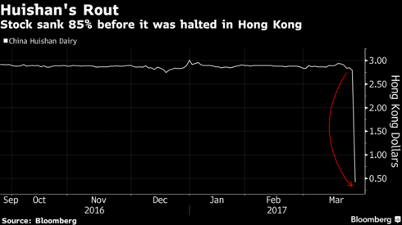
Trading Strategies – HK Small Caps
At the end, didn’t go ahead this strategy
Hong Kong stock exchange enlists AI in fight against rule breakers
The Enigma Network: 50 stocks not to own (David Webb)

Slide 29
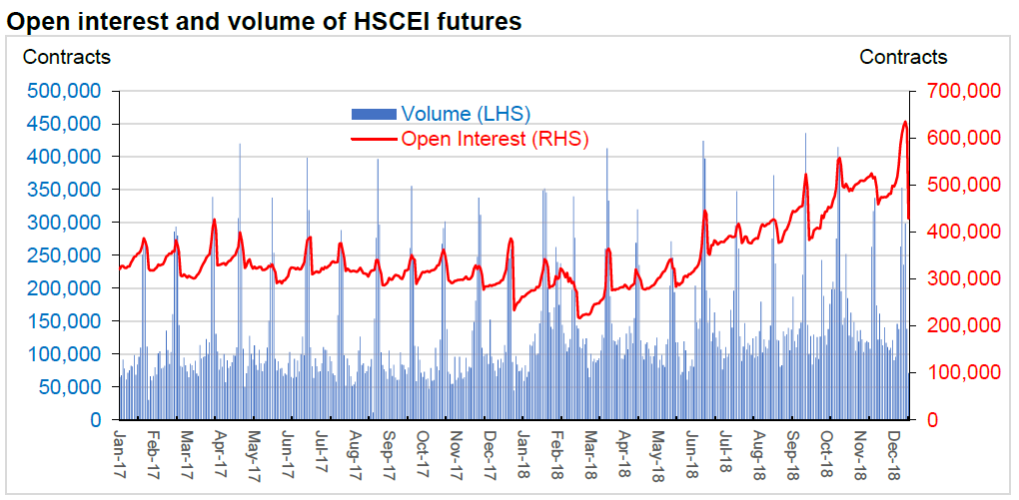
Trading Strategies – HKFE Wave Trading
Index Future transaction cost is low (HK$15 per contract from IB)
Has enough liquidity and high leverage (Each point is HK$50, HK$10 for mini contracts

Slide 30
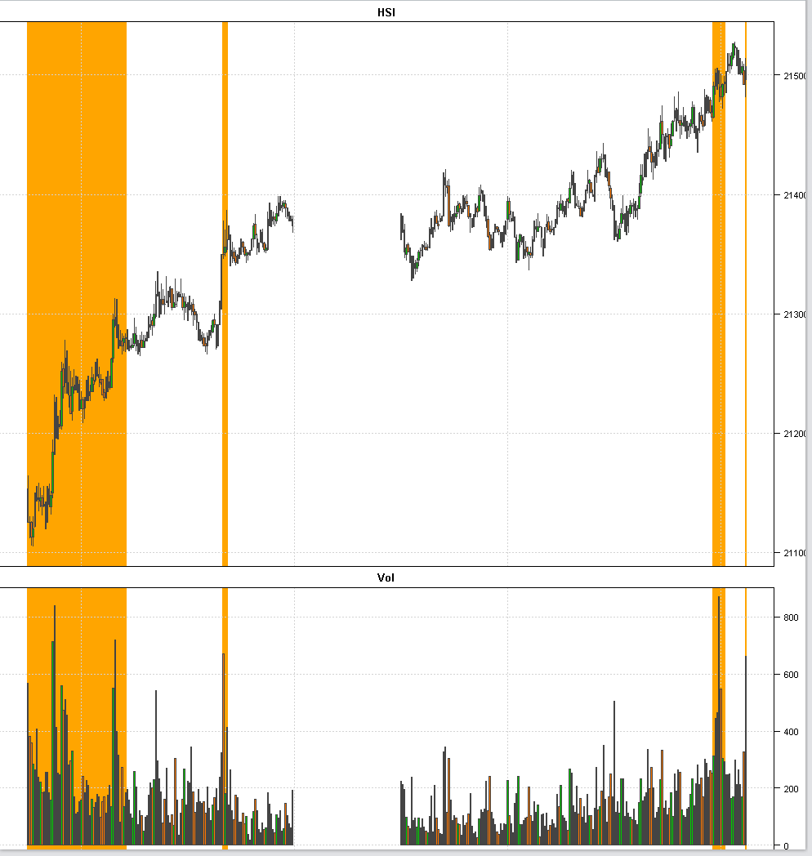
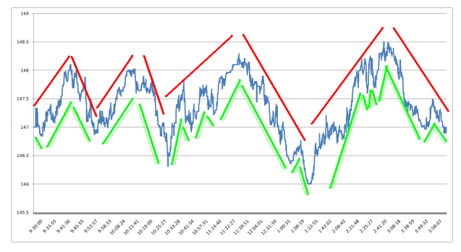
Trading Strategies – HKFE Wave Trading
Objective: detect short term trends and regime shift. Use HKFE because of lower transaction costs
The market goes through
volatility and volume regime intraday.
For short term price action,
a security goes typically through several trends

Slide 31
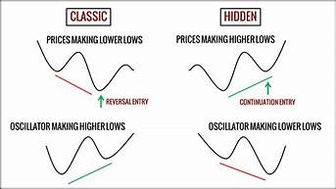
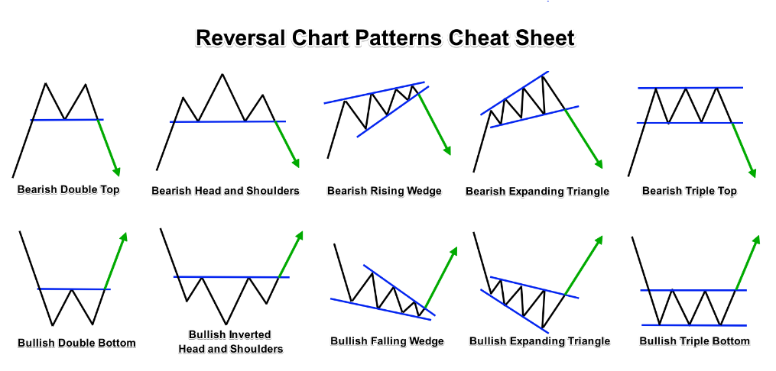
Chart Patterns for Futures Trading
Objective: apply pattern recognition, detect signals that are statistically significant for market action.
MACD chart patterns
Support and Resistance Level – based on chart patterns

Slide 32
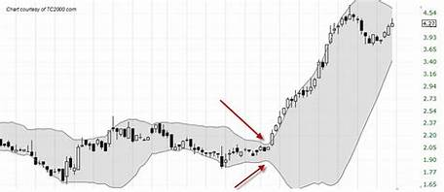
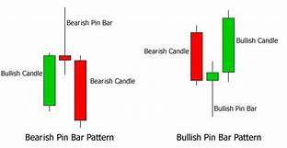
Signals for Futures Trading
Bollinger bands
Needle Pin Reversal Pattern

Slide 33

Demo: Bit Coin Trading
2010-May-22:
Laszlo Hanyecz agreed to pay 10,000 Bitcoins for two delivered Papa John's pizzas
2019-Nov-5:
1 bitcoin = US$ 9321 (~HK$ 72,871)
2 Pizzas worth:
US$ 93 Millons
HK$ 728.7 Millons

Slide 34
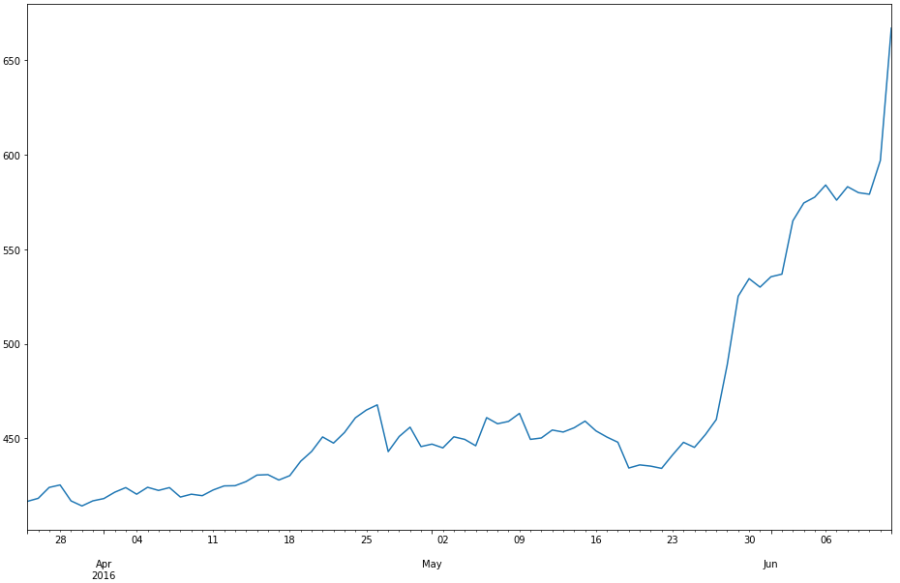
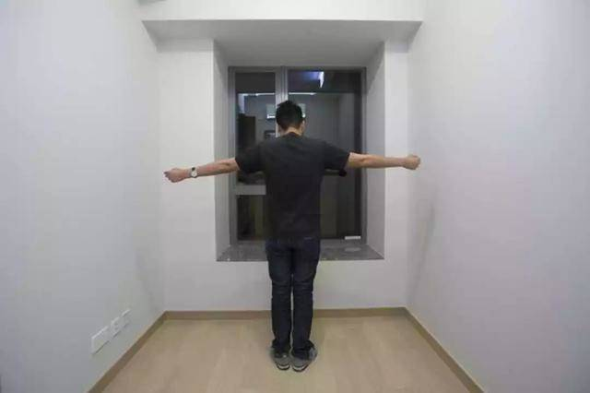
Demo: Bit Coin Trading
2016-May-22:
1 bitcoin = US$ 434 (~HK$ 3,385) 100 bitcoins = US$ 43,4000 (~HK$ 338,500)
2019-Nov-5:
100 bitcoin = US$ 932,100 (~HK$ 7,287,100)
Buy a nano flat
(納米樓)
My Bitcoin Pizza Day

Slide 35
Demo: Bit Coin Trading
SMA Crossover Strategy: leading and a lagging simple moving averages
Leading SMA has a shorter look-back period that lagging moving average. Hence, by definition, leading SMA will be more sensitive to most recent price moves; lagging SMA will be slower to react (Comparing to Long/Short term Sentiment)
Code Example
Data Collection (download from website)
Exploratory Data Analysis (summary, table, charts etc.)
Define Strategy Logic
LONG: if Leading SMA is above Lagging SMA by some threshold
SHORT: if Leading SMA is below Lagging SMA by some threshold
FLAT: threshold is applied to filter out weak signals and flat the current position
Back Testing
Compare Performance to the Benchmark

Slide 36
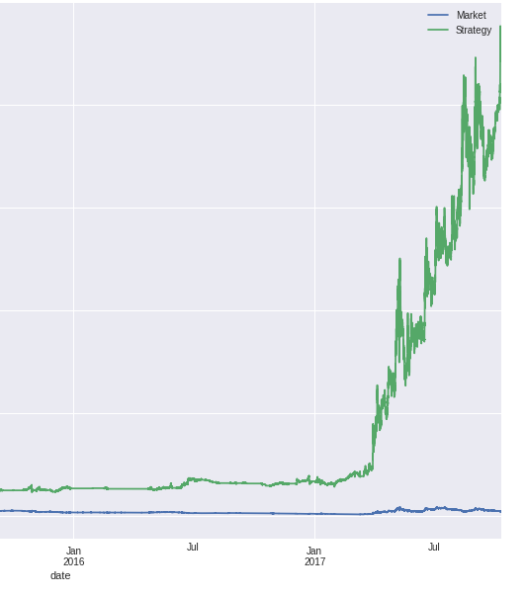
Demo: Bit Coin Trading
Back test shows good performance. But doesn’t consider the following:
Transaction Cost
Infrastructure cost
Commissions
Shorting (cost or legal)
Slippage (Latency, Spread, Volatility, Liquidity)
Market Impact

Slide 37
Demo: Bit Coin Trading
Regime Switching: carefully select the period and beware of structural changes in a data series
Data Frequency: the resolution of the data (day, minute, second, tick) to match the trading horizon (high to low frequency trading)
Performance Tuning: adjust the algos logic and params to (over)fit your historic training data (does future repeat itself? back test results are usually “over fit”)
(mini) Black swan: win candy, lose factory
Paper Trading

Slide 38

Agency Execution Algos
Trading for commissions
Facilitate Institutional clients
Does not own the PnL from the executions
Notes:
Before earn $10 share $5, now earn $10 but share only $1

Slide 39
Basic Market Micro-structure
Exchange Limit Order Book
Price Queue: Bid, Bid Size, Ask, Ask Size
Order Depth: Best Bid/Ask and Level 2
Queue Priority: Price and time
Bid/Ask spread: Difference between Best Bid/Ask
Summary Statistics: Average bid/ask size (queue size), Average spread
Size | Bid | Ask | Size
1,000,000 | 9.5 | 9.6 | 20,000
500,000 | 9.4 | 9.7 | 50,000
700,000 | 9.3 | 9.8 | 80,000

Slide 40
Basic Market Micro-structure
Trades & Executions
Execution (Trade): Buy at Best Ask (Lift the offer), Sell at Best Bid (Hit the bid)
Trade Details: Timestamp, trade price & volume (quantity)
Daily Stats: Open/High/Low/Close/Volume
Summary Statistics: ADV (Average Daily Volume) , Close Volatility
Timestamp | Price | Volume
11:22:30.001 | 9.5 | 1,000
11:22:32.853 | 9.6 | 2,000
11:22:32.942 | 9.5 | 4,000

Slide 41
Basic Market Micro-structure
Exchange Orders
Order Side: Buy, Sell, Short Sell
Order Type: Limit Order, Market Order, Auction Order, Funari Order (limit-to-close order in Japan), Centre Point Order (fill at midpoint of bid/ask in AU market)
(Algo Limit / Market Order vs Exchange Limit / Market order)
Order Amendment: Price, Quantity change (up/down), Cancel. Not all market support order amendment (such as China) and requires cancel/resend
Order Condition: Fill-or-Kill, Fill-And-Kill
TIF (Time-in-Force): Day Order, GTD (Good-Till-Date), GTC (Good-Till- Cancel)

Slide 42
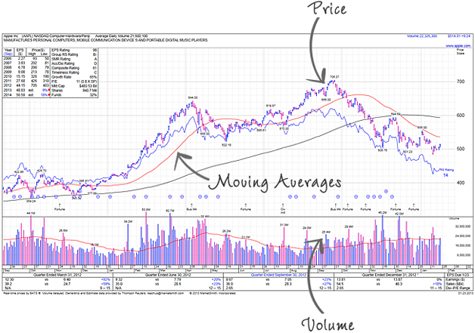
Basic Market Micro-structure
Volatility (Price): price change rapidly and unpredictably. Stocks usually have large open close price difference
Liquidity (Volume): can be quickly bought or sold in the market. Stocks have high daily volume and best/Ask spread is usually tight

Slide 43

Type 1: Reduce Signalling Algos
Demand liquidity without signal the market
Objective: Hide the true intent
Example Algos: Stealth, Iceberg, Peg

Slide 44
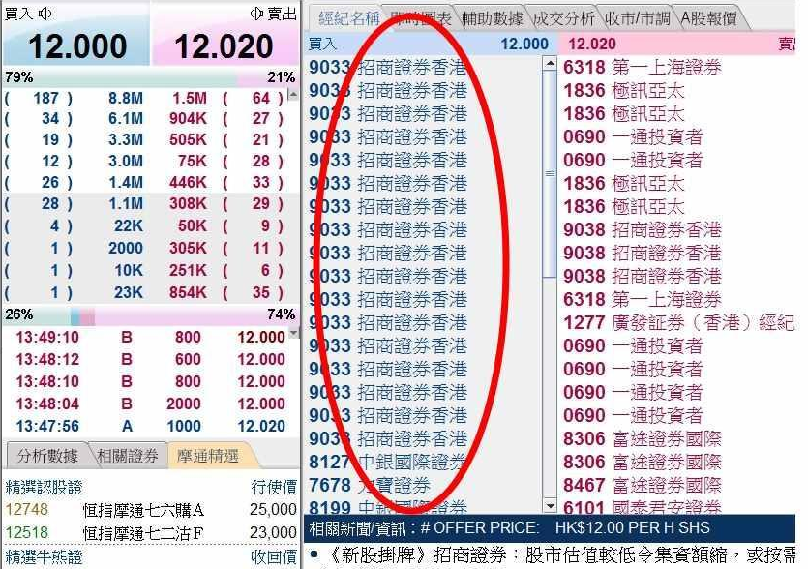
Algo - Stealth
Example : IPO Stabilization (護盤)
Queue up large quantity of buy orders during market open at IPO price
Accumulate stock positions at the IPO price if the stocks happens to trade around IPO price
When the stock price goes up later, use Stealth Algo to unload the position without showing in the order queue (HKEx display the broker ID)

Slide 45
Algo - Stealth
use FAK (Fill-And-Kill) order when the price is immediately executable
leave residual quantity (randomize) such that it will not move the price
Example: Stealth Sell 0700.HK 1,000,000 @ 350
Size | Bid | Ask | Size
50,000 | 349.8 | 350.0 | 20,000
40,000 | 349.6 | 350.2 | 50,000
700,000 | 349.4 | 350.4 | 80,000
No Action
Size | Bid | Ask | Size
70,000 | 350.0 | 350.2 | 50,000
50,000 | 349.8 | 350.4 | 80,000
40,000 | 349.6 | 350.6 | 20,000
Immediately hit the bid with size < 70,000

Slide 46
Algo - Stealth
Any other use case?
Illiquid stocks
Size | Bid | Ask | Size
2,000 | 9.5 | 9.6 | 1,000
 | 9.4 | 9.7
 | 9.3 | 9.8 | 2,000
1,000 | 9.2 | 9.9 | 1,000
1,000 | 9.1 | 10.0

Slide 47

Algo - Iceberg and Peg
Iceberg
only send (display) partial order quantity to the exchange at each time
refill the quantity when see fills
randomize the display quantity
broker ID market may only send new order after the partial order fully filled
Peg
float partial order to follow Bid/Mid/Ask price
can have offset (+/- x ticks from the above price)

Slide 48
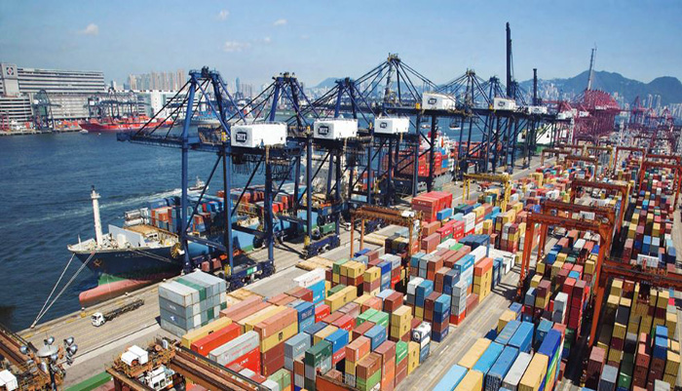
Type 2: Benchmark Algos
Works on relatively large orders
Objective: reduce market impact and track or beat the price benchmarks
Example Algos: POV, VWAP, TWAP, IS, MOC

Slide 49
Algo - POV
POV (Percent of Volume) – execute an order relatively quick but do not want to cause too much market impact. POV% parameter controls the execution speed. Algo will try to make its executed volume to be POV% of the market executed volume.
QTY = POV% * MEV – OEV
QTY - quantity to be executed
POV% - POV parameter. e.g. 30%
MEV - Market executed volume since strategy started
OEV - Order executed volume since strategy started

Slide 50
Algo - POV
Example: Buy 1,000,000 shares of 0700.HK (Tencent) with POV% = 30%
QTY = POV% * MEV – OEV
MEV - Market executed volume
OEV - Order executed volume
Trade | Size | MEV | OEV | QTY | Actual POV (OEV+QTY)/MEV
T1 | 2,000 | 2,000 | 0 | 600 | 0.3
T2 | 1,000 | 3,000 | 600 | 300 | 0.3
T3 | 5,000 | 8,000 | 900 | 1,500 | 0.3
T4 | 3,000 | 11,000 | 2,400 | 900 | 0.3

Slide 51
Algo - POV
Volume Tracking
ITM (in-the-money) vs OTM (out-the-money): if Algo has a limit price, only count the ITM volume
Count only on-exchange trade
Additional parameters
Active: more willing to trade and track closer to the target
Normal: balance the speed and price improvement
Passive: more willing to wait for price improvement
Main Error Checks
Reject order with POV% > 50 as too much market impact. Industry practice is 33% for max desired impact

Slide 52
Algo - VWAP
VWAP (Volume Weighted Average Price) is a benchmark Algo which try to track or beat the volume adjusted average market price over the order trading duration.
Trade 1: 10,000 shares @ $70
Trade 2: 20,000 shares @ $72
VWAP = (10,000 * 70 + 20,000 * 72) / (10,000 + 20,000) = 71.33
Objective: trade a sizable CD (careful discretion) order that the trader does not have a specific view to the market direction. If there’s a view on the market direction, for example, buy order on a trending up market. For this case, the order is preferred to be traded by liquidity seeking algo that completes the order as quick as possible rather than worked by VWAP Algo gradually over the day (as the view is that the price is going to go up and buy earlier will give a better price).
Two main components to achieve VWAP: Scheduling and Order Placement

Slide 53

Algo - VWAP
Scheduling
Example: VWAP Buy 1,000,000 shares of Tencent over-the-day (9am to 4pm)
Execution progress throughout the trading duration. It is based on a historical volume profile to predict the current day volume pattern.
The profile is usually constructed based on 20 days average (or median) and taking away the outliers and special trading days (like half day trading or index rebalance days).

Slide 54
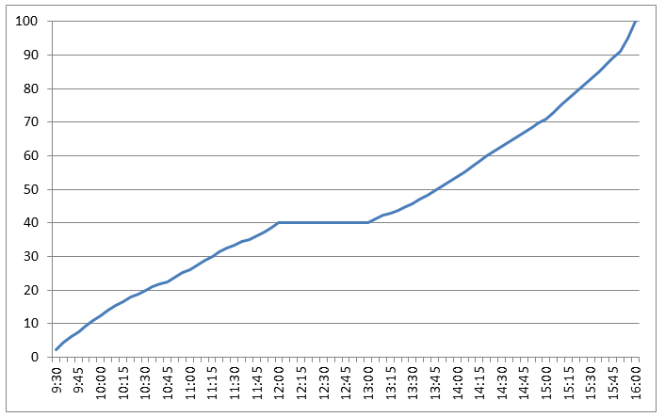
Algo - VWAP
A typical HK volume profile for a stock. Usually it has higher volume during the open and close. The volume profile tells the Algo the percentage of completion during different time periods.
Example
VWAP Buy 1,000,000 Tencent
Time | Target% | Target Qty
10:00 | 12% | 120,000
12:00 | 40% | 400,000
15:00 | 71% | 710,000
16:00 | 100% | 1,000,000
Bonus Question: if the VWAP order arrive in the middle of day, say 11am, what will happen to the volume profile scheduling?

Slide 55
Algo - VWAP
Time | Volume (%)
09:30 | 0.24
09:35 | 3.66
09:40 | 5.56
09:45 | 6.40
09:50 | 8.10
09:55 | 9.11
10:00 | 10.29
.. | ..
.. | ..
.. | ..
.. | ..
.. | ..
15:30 | 67.79
15:35 | 69.42
15:40 | 71.33
15:45 | 73.13
15:50 | 75.80
15:55 | 79.34
16:00 | 100.00
The volume profile data is usually organized in 5-min bins (or 1-min)
All the time that are in-between the bin are interpolated
Normally for a VWAP market and ITM order is expected to be completed and it performs “finish up” (which trade very actively) to complete the order just before the order end time

Slide 56

Algo - VWAP
Stock historical volume profile seems a good proxy to predict the current day volume pattern. Should every stocks has its own volume profile?
Not every stocks should have an individual stock volume profile
Only stocks that exhibit high correlation in daily volume patterns (It means those stocks exhibit relatively consistent volume patterns. Those stocks are usually the liquid stocks (for example from stocks from Hang Seng Index)
For those stocks (usually mid-cap or illiquid stocks) that they do not have consistence volume profile, use market volume profile or TWAP

Slide 57
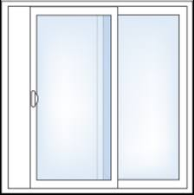
Algo - VWAP
Order Placement
Once there is a target working schedule from volume profile, the Algo will decide on how to place the orders (price and quantities) to the exchange to achieve the schedule while getting the best possible price.
Behind
Ahead
Ahead or behind Window
Allows 2% to 5% deviate from the volume profile target.
The general idea is to start with passive order to improve the pricing and work progressively if the Algo is starting to get behind the volume profile schedule
The windows size depends on the price volatility ← How ? (Hints: aim at consistent performance)

Slide 58
Algo - VWAP
Order Book Imbalance
The ratio between the bid and ask size. We can take into account the first few levels (for example 3 levels) of the order book while the top level of the book will have higher weighting.
For buying order, if the bid size is much larger than the ask size, like the example below, the VWAP Algo should be more willing to trade aggressively as the price is more likely to go up rather than down. Vice versa, if the Ask size is larger, the Algo should wait more patiently.
Size | Bid | Ask | Size
1,000,000 | 9.5 | 9.6 | 20,000
500,000 | 9.4 | 9.7 | 50,000
700,000 | 9.3 | 9.8 | 80,000

Slide 59
Algo - VWAP
Order Running VWAP price vs Current Market Price
During trading, the Algo will compare the order running VWAP price to the current market price. If the current market price is better than the VWAP price, the Algo should be more aggressive to execute as it will improve the overall VWAP pricing.
For example, if the Buy Order running VWAP Price is 9.9, and the current market is offering at 9.6 (shown in the order book below), the Algo should be more active to take offer at 9.6 now.
Size | Bid | Ask | Size
30,000 | 9.5 | 9.6 | 20,000
500,000 | 9.4 | 9.7 | 50,000
700,000 | 9.3 | 9.8 | 80,000

Slide 60
Algo - VWAP
Bid/Ask Spread
Bid/Ask spread is the price different between bid and ask. It is the transaction cost when Algo crossing the spread to get immediate executions.
Example: when the Bid/Ask is wide (how to determine it’s wide or not?), the Algo should wait more patiently for the spread to be narrowed and avoid crossing the spread at this moment. Alternatively, Algo can send the orders between the bid/ask price to narrow the spread by itself.
Size | Bid | Ask | Size
20,000 | 9.5 | 9.9 | 20,000
60,000 | 9.4 | 10.0 | 50,000
70,000 | 9.3 | 10.1 | 80,000
Assume Tick Size = 0.1

Slide 61
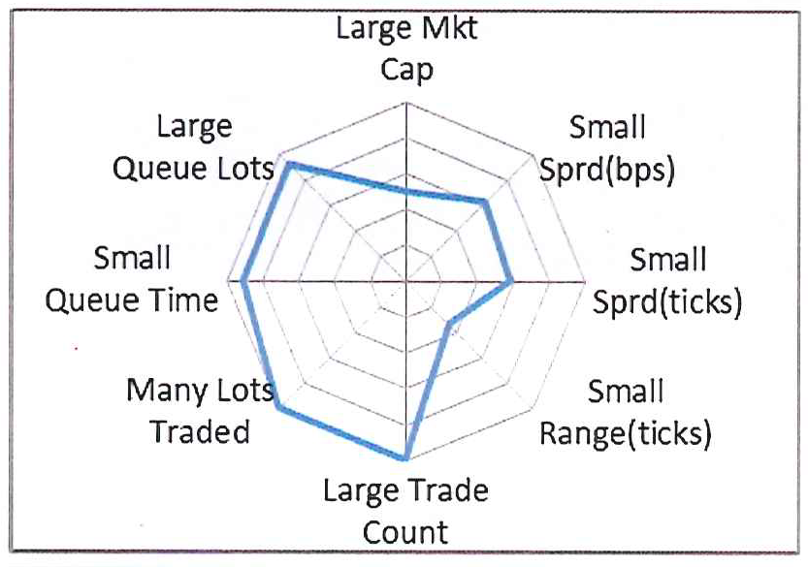
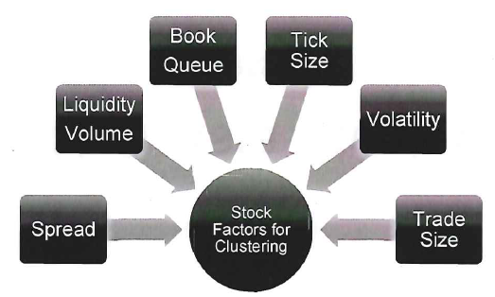
Algo - VWAP
Each individual factor is simple but put it altogether would require tuning and back test
Weighting and clustering are common techniques
Source: Goldman Sachs Securities Division

Slide 62
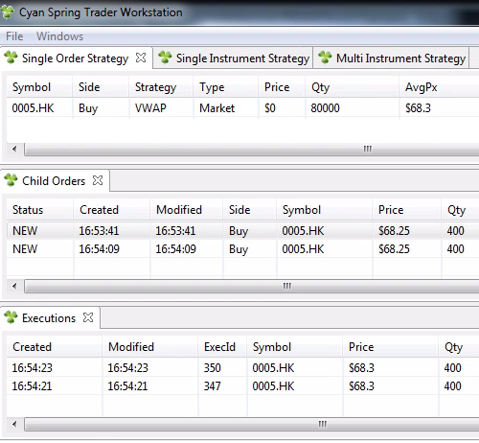
Algo - VWAP
Exchange Orders Management
One VWAP Algo order manages many Child (Exchange) orders.
If Algo needs to send 3,000 Qty to the exchange. Which one is preferred?
1 order x 3,000 QTY
3 orders x 1,000 QTY
Queue sizes: When queue size is large, send 1 x 3000 QTY so that we can have sizable quantity waiting in a good queue position.
Price Volatility: For high volatility, send 3 x 1000 QTY so that we can have more flexibility to amend different child orders.
Notes:
SG market has long order queue

Slide 63
Algo - VWAP
Exchange Orders Management
When Algo needs to amend or cancel the orders in the exchange, it will always pick the one that loses the least queue priority. In the order book below (T denotes the orders from others, O is our orders. Smaller number indicates higher queue priority as they have been input to the book earlier), suppose we have to cancel one order at the 9.5 Bid queue, the Algo will cancel O16.
Broker Queue | Size | Bid | Ask | Size
T11, O12, T13, T14, T15, O16 | 1,000,000 | 9.5 | 9.6 | 20,000
T21,T22,O23 | 500,000 | 9.4 | 9.7 | 50,000
T31,T32,T33,T34,T35 | 700,000 | 9.3 | 9.8 | 80,000
Order Actions:
Amend Price - lose queue priority
Amend Quantity up - lose queue priority
Amend Quantity down - preserve queue priority

Slide 64
Algo - VWAP
Exchange Orders Management
In certain cases, when Algo need to get execution, it will send a new order rather than amending any existing exchange orders to preserve the original queue priority.
Another exchange orders manager is to control the number of orders in the same price queue. As HK exchange shows the broker ID of each order in the price queue, it is generally considered not a good practice to display too many orders (Broker ID). The number of orders should be proportion to the numbers of orders in the queues (i.e. the Algo can send more orders if there are many other orders in the queue).
(HK shows Broker ID but not the quantity from each broker ID. If Algo sends too many of small orders, it will displays too many of the same Broker ID. For illiquid order queue, it may be questioned as the broker is trying to create false signal to fool the investors)
(Exercise: walk through order modification scenarios)

Slide 65
Algo - TWAP
TWAP (Time Weighted Average Price) is everything the same as VWAP Algo, except it does not use volume profile. Instead, the schedule is equally divided by the trading duration (can think of it as linear volume profile).
Use Case
Mid-cap or illiquid names that do not have stable daily volume patterns
Popular in markets that the volume patterns are not dominant (usually the markets with no lunch break and with short trading hours, such as Taiwan)

Slide 66
Algo – VWAP & TWAP
Additional Parameters (VWAP & TWAP)
POV%: it’s a volume constraints (rather than target) such that while VWAP/TWAP trade over the day gradually, it cannot trade over certain % of market volume. It is usually for relatively large order
Cleanup Price: if the stock reach certain price, Algo deviates from the volume curve schedule and demand liquidity actively at or better than the cleanup price. (what happen when the stock price moved away from cleanup price and order is still not completed?)
Other Notes
Half-day trading requires special half-day volume curve or map VWAP to TWAP
OTM (Out-of-Money) price and short sell orders may cause order stacking
HK VWAP off 5-6 bps; JP off 1-2 bps. May attribute to retail vs institutional flow

Slide 67
Algo - Implementation Shortfall
Implementation Shortfall (IS): the difference between the decision price (usually arrival mid-price and the final execution price for a trade (aka the slippage).
Scheduling
The Algo generally balance the pace of executing too fast (market impact cost) vs too slow (opportunity cost of the price move away). The POV% increases when price is more favorable and vice versa.
Buy Price | POV%
5.6 | 10
5.5 | 15
Arrival Px → 5.4 | 20
5.3 | 25
5.2 | 30
Notes:
Assume mean-reversion.

Slide 68
Algo - Implementation Shortfall
The POV% schedule varies from different stocks. It is generally based on the stock cost model where mainly taking into account the historical volume pattern, liquidity and volatility.
The model implicitly assumes “mean reversion” (i.e. prices and returns eventually move back towards the mean or average). If stock is trending, may use other Algos (which one?).
Order Placement: the way to place the orders (price and quantities) to the exchange to achieve the schedule while getting the best possible price is the same as in VWAP
Notes:
Assume mean-reversion.

Slide 69
Algo – Market On Close
Tracker Fund (2800.HK)
Top Holdings
HSBC Holdings | 10.45%
AIA Group Ltd. | 8.71%
Tencent Holdings | 8.48%
China Construction Bank | 8.30%
China Mobile | 5.43%
…… full list
Key Info
Primary Benchmark | Hang Seng Index
Replication Method | Full Replication
Fund Manager | State Street Global Advisors
Annual Charges | 0.09%
Total Net Assets | HK$ 79.9 B
Hang Seng Indexes
Quarterly rebalancing is undertaken in Mar, Jun, Sep & Dec, which includes update of the freefloat-adjusted factors, cap factors and issued shares, and changes of index constituents according to the quarterly index review results.

Slide 70
Algo – Market On Close
Some ETF funds (like HK Tracker Fund 盈富基金) passively track the underlying index constituents
The constituents may be re-weighted or new stocks will be added to the index. The ETF funds need to adjust the portfolio according to the new weighting
As the transaction performance are mark-to-market by the closing price, use Market-on-Close Algo to benchmark with the closing price

Slide 71
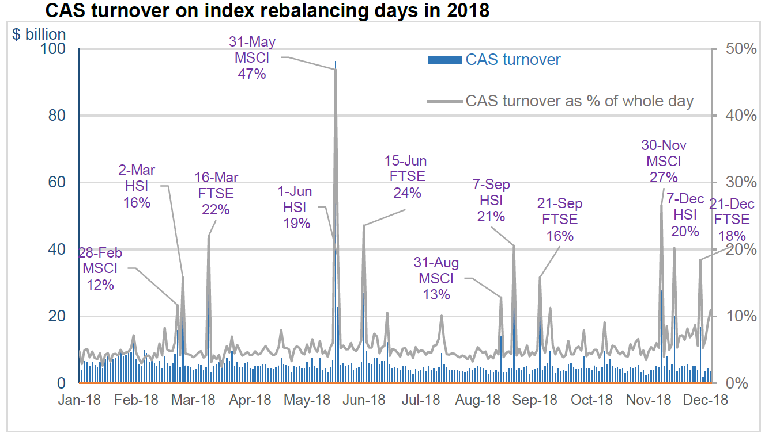
Algo – Market On Close

Slide 72
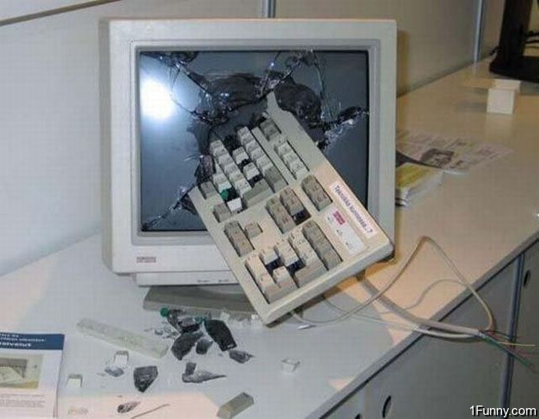
Algo – Market On Close
A trader experience before using before Market-On-Close Algo

Slide 73
Algo – Market On Close
Market-on-Close (MOC) Algo benchmarks with the closing price
Daily closing trade or Index Rebalance trade where the index constituents re-weighting or adding new stocks. The ETF funds need to adjust the portfolio according to the new weighting
Orders non-completion can be hedged by the Index Future
Risk MOC: the firm takes the positions and guarantee performance (e.g. 10bps better than closing price)
Agency MOC: the firm purely acts as broker for conducting the transactions

Slide 74
Algo – Market On Close
Divide the order into pre-trade portion (trade before the closing auction) and on-close portion (trade into the closing auction). The ratio is decided by the trader
The objective is to balance the price improvement from the pre-trade portion vs the on-close portion which support the closing price itself.
If the order is in right flow (e.g. buying a name which is adding to the index or re-weighting upward), the stock is expected to have large buy pressure during the closing that should potentially push up the closing price. Hence the pre-trade portion (executed before closing) should have lower price and therefore improve the overall executed price.
(If pre-trade can generally improve the price performance, why not 100% pre-trade the MOC order?)

Slide 75
Algo – Market On Close
Pre-trade is generally done via VWAP-style with a reverse volume curve (calculated backwards from closing time)
The order start time is calculated by ADV (or Rebalance ADV) or manually input a start time.
Incidents Sharing
Daily MOC vs Rebalance MOC parameters input
Before HK closing auction, jammed the last 1-min throttle and orders incompletion

Slide 76
Algo – Market On Close
Pre-trade volume curve
Traders adjust the volume skewness towards the closing time.
Why is the shape of the MOC volume curve is always concave towards the closing ?

Slide 77

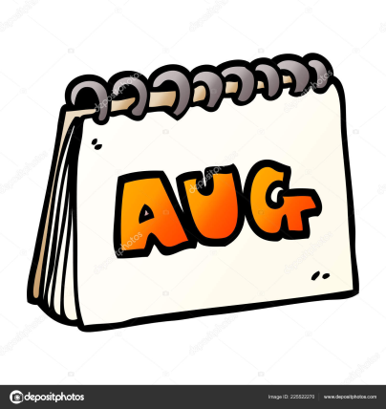
Algo – Market On Close
How to determine the ratio of Pre-trade vs On-Close
10%-90% or 20%-80% or 30%-70% ?
Announce Date
Effective Date
After announce date, keep track of the stocks daily volume vs ADV until effective date
The excess to the ADV volume could be the counter-flow orders (non-index tracking funds such as Hedge Funds). Larger counter-flow volume mean more towards On-Close portion
Look at previous similar index rebalance trades and volumes

Slide 78
Benchmark Algos
 | Objective | Urgency | Scheduling | Completion
POV% | % of volume | High | Market volume driven | Can complete any time as long as seeing enough volume
VWAP/TWAP | Track volume or time adjusted average price | Low | Historical volume profile | Trade gradually along the order duration
Implementation Shortfall | Track arrival mid-price (or other) | Medium | Market volume driven and speed depends on the price | Can complete any time as long as seeing enough volume
Market on Close | Track closing price | Medium | Reverse (from end time) volume curve skewed toward closing | Complete at the market close
Notes:
Assume mean-reversion.

Slide 79
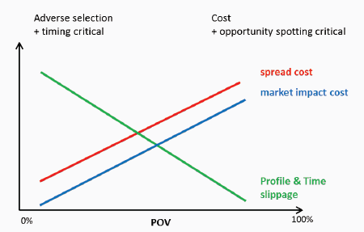
Transaction Cost Analysis
TCA is the study of trade prices to determine whether the trades were arranged at favorable prices (buy low price and sell high price) or at best execution
Pre-trade Analysis
is the process of taking known parameters of a planned trade and determining an execution strategy that will minimize the cost of transacting for a given level of acceptable risk.
it is not possible to reduce both projected risk and cost past a certain efficient frontier, since reducing risk tolerance requires limiting market exposure and thus trading faster. In this situation, market impact cost is much greater than for trades that accept greater risk and are executed more slowly.
Notes:
Assume mean-reversion.

Slide 80
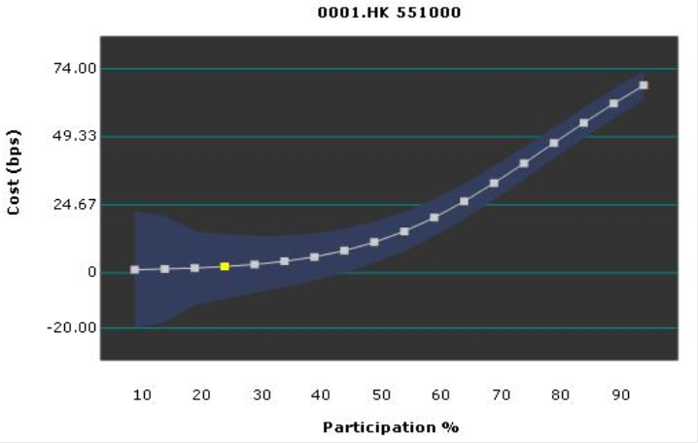
Transaction Cost Analysis
Pre-trade Analysis Examples
VWAP: “Ahead-of-behind” window size, order book parameters (imbalance, spread) weightings
Implementation Shortfall: participation% in different price level
Market-on-Close: PreTrade% vs onClose%, the PreTrade curve starting time and shape
The above analysis are mostly based on stock price volatility, liquidity (ADV) and order book features (average queue size, spread etc.)
Notes:
Assume mean-reversion.

Slide 81
Transaction Cost Analysis
Post-trade Analysis
Recording the data from previous trading periods, including trade timing, arrival price, average execution price, and relevant details about market movement.
These data are then measured and compared to several benchmarks, such as the volume-weighted average price, time-weighted average price, participation-weighted average price, or a variety of other measures.
Implementation shortfall is a commonly targeted benchmark, which is the sum of all explicit costs (transaction cost, spread) and implicit costs (market impact, delay cost, and opportunity cost)
After measurement, costs must be attributed to their underlying causes. This analysis is used to evaluate performance and monitor future transactions.
Notes:
Assume mean-reversion.

Slide 82
Transaction Cost Analysis
Post-trade Analysis Example
VWAP: measure the % of executions on Passive Touch vs Aggressive Touch
For Buy orders, Passive Touch is the executions happens on the Bid side, while Aggressive Touch happens on the Ask side. Vice versa for the Sell orders.
Aggressive Touch demands liquidity immediately and has to pay the spread to get the execution. Spread cost is one major type of transaction cost in execution.
Buy Order Example
Passive Touch
Aggressive Touch
Size | Bid | Ask | Size
30,000 | 9.5 | 9.6 | 20,000
500,000 | 9.4 | 9.7 | 50,000
700,000 | 9.3 | 9.8 | 80,000

Slide 83
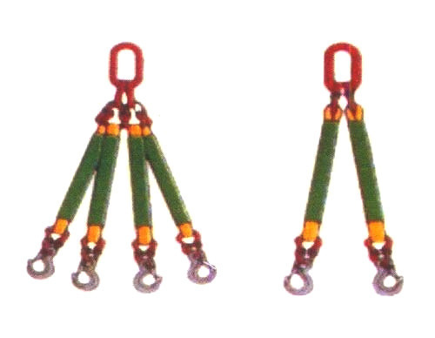
Type 3: Multi-legs or Portfolio Algos
Algo manage more than one leg (algo order) simultaneously
Objective: Work on multiple Algo orders to fulfill a common goal
Example Algos: Pair, Market Making

Slide 84


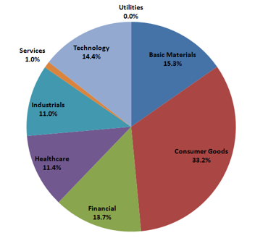
Algo - Pair
For a sector neutral portfolio where it maintains the same ratio of sectors

Slide 85
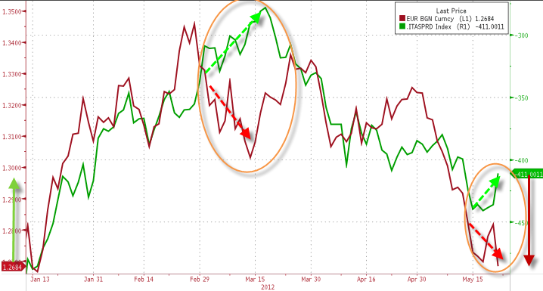
Algo - Pair
Do a switch trade (換馬) where selling the “relative” over-value stock and buying the under-value stock from the same sector (or same companies in different markets - like China-A vs HK-H shares)

Slide 86
Algo - Pair
Pair Algo has two legs (one buy and one sell with two different names).
For “switching trade” where to sell the over-value stock and buy the under-value stock from the same sector
Manage the execution progress of two legs and avoid legging (that’s one leg is executed faster than the others)
Can control which leg (usually sell side for Dollar neutral) to execute first. Also Short Sell side (why?) generally needs to be executed first
The undervalue/overvalue relation is expressed as Buy/Sell <= Price Ratio

Slide 87
Algo - Pair
Example
When Tencent trading over around $400 is overvalue and Alibaba trading under around $200 is undervalue
Switch from Tencent to Alibaba ➔ Sell Tencent and Buy Alibaba when Buy Tencent /Sell Alibaba <= 0.5 (“Relative” Price Ratio)

Slide 88

Algo - Pair
The execution happens when the specified price ratio is met. It is when the immediate execution price (i.e. Buy on Ask and Sell on Bid) is within the ratio
Objective: Buy Alibaba / Sell Tencent <= 0.5 Buy @ Ask (200.2) and Sell @ Bid (400) Buy/Sell price ratio = 200.2/400 = 0.5005 which is NOT <= 0.5 and hence NO action
Buy |  |  | Sell
Bid | Ask |  | Bid | Ask
200 | 200.2 |  | 400 | 400.2
Alibaba price down and Tencent up Buy @ Ask (200) and Sell @ Bid (400.2) Buy/Sell price ratio = 200/400.2 = 0.49975 which is <= 0.5 and start execution
Buy |  |  | Sell
Bid | Ask |  | Bid | Ask
199.9 | 200 |  | 400.2 | 400.4

Slide 89
Algo - Pair
If only Tencent goes up while Alibaba stay the same, can use bait order (either wait on bid or ask) to improve the chance of execution
Bait Buy Alibaba @ Bid (200) and when fill at 200, Sell Tencent @ Bid (400.2) Buy/Sell price ratio = 200/400.2 = 0.49975 which is <=0.5
Buy |  |  | Sell
Bid | Ask |  | Bid | Ask
200 | 200.2 |  | 400.2 | 400.4
Bait Sell Tencent @ Ask (400.4) and when fill at 400.4, Buy Alibaba @ Ask (200.2) Buy/Sell price ratio = 200.2/400.4 = 0.5 which is <= 0.5
Buy |  |  | Sell
Bid | Ask |  | Bid | Ask
200 | 200.2 |  | 400.2 | 400.4
If bait at Bid/Ask are both are ok, which one to choose in above case?
Can Buy/Sell ratio expressed as “>” rather than “<=“

Slide 90
Algo - Pair
Price Ratio can be adopted for Spread trade where the input is “Buy-Sell < Spread”. One example use case is for trading the Stock vs “Stock Right”
Cross market (A-H Pair) order needs FX feed to convert the price ratio to same currency
Additional parameters:
VWAP/TWAP: execute the ratio trade gradually over the day
POV%: execute as fast as possible but still within the volume constraints
Main Error Checks
Reject the order if the ratio (or spread) is 10% more ITM than the current market
Warn the order if the ratio (or spread) is 10% more OTM than the current market

Slide 91
Algo - Market Making
Business driver
Earn spread, Waive stamp duty / exchange fee
Typical products: Warrants, CBBC, Listed Future/Options, ETF
Type of Market Making (MM)
Quote Request: respond to the request to provide liquidity. Generally it only requires to full-fill certain % of the request per day
Continuous MM : continuously making the market to fulfill min spread, min show quantity, min show time, min hours of a trading day
Reference price calculation
Based on customized formula and can subscribe to multiple instruments to source the pricing information
Additionally for non-delta 1 products (such as Options and Warrants) based on underlying instruments and static data, use Quantlib Black-Scholes option pricing library to estimate the fair value, option Greeks (delta, gamma), implied volatility

Slide 92
Algo - Market Making
Market Making Orders Management
Placing two sided (buy & sell of same name) of market making orders into exchange continuously (react to price change and/or timer-based) or opportunistically (quote request)
The price and quantity of the orders are based on the underlying instrument spot price, reference price, conversion ration, min spread and liquidity obligations. For options type of products, also needs the Greeks and implied volatility
Adjusting (cancel or amend) the orders automatically according to the rules and market conditions
Monitor the order quantity and (partial) fill, depends on the objective of queue priority, can send new order or amend the existing quantity to maintain the liquidity
keeping track of order timing and can setup conditions to cancel and resubmit orders

Slide 93
Algo - Market Making
Manual Override
Setup the min/max spread on top of the existing requirements
Set offset from the calculated spread (e.g. ask -1 tick)
Widen the spread or temporarily suspend the market making if the market is too volatiles (e.g. Future drop 100 points in 5 mins, underlying go up 3% in 1 mins)
Reference Data
Include order capacity information to distinguish between Market Making or House orders
Position keeping on intraday or aggregated (e.g. monthly) level

Slide 94
Algo - Market Making
Risk Management
Setup automatic hedging of underlying instruments or with other Future and Options. When trading the underlying, follows the respective rules (such as short sell up-tick rule of the underlying stocks)
Unwinding the positions at the end of day according to specific rules
Directional (Delta Risk): Any unhedged long/short position
Interest Rate Risk (Rho Risk): Manage interest rate estimates
Dividend Risk: Manage Dividend payout estimates
Execution Risk: Fast system to capture the mis-pricing
Liquidity Risk: Determine appropriate trading size

Slide 95
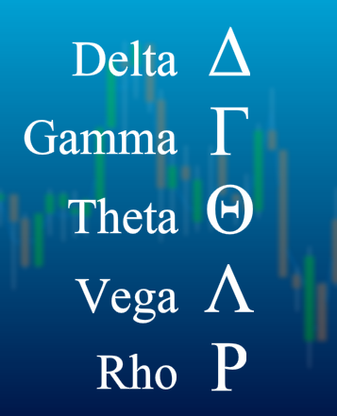
Algo - Market Making
The Greeks
Gamma Risk (Rate of Change of Delta)
Theta Risk (Time Decay)
Vega Risk (Implied volatility)
Hedging Calculation
Black-Sholes model
Finite Difference model

Slide 96
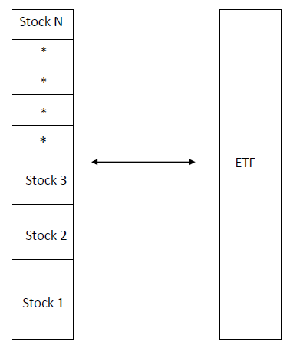
Algo - Arbitrage
Arbitrage - simultaneous buy and sell of an asset to profit from a price mis-match. Profits by exploiting the price differences of identical or similar financial instruments on different markets or in different forms. Arbitrage exists as a result of market inefficiencies
ETF Arbitrage
Buy/Sell ETF against the underlying share holdings
Index Arbitrage
Buy/Sell Index Contract against the underlying share holdings
(Need to take transaction cost into account )

Slide 97
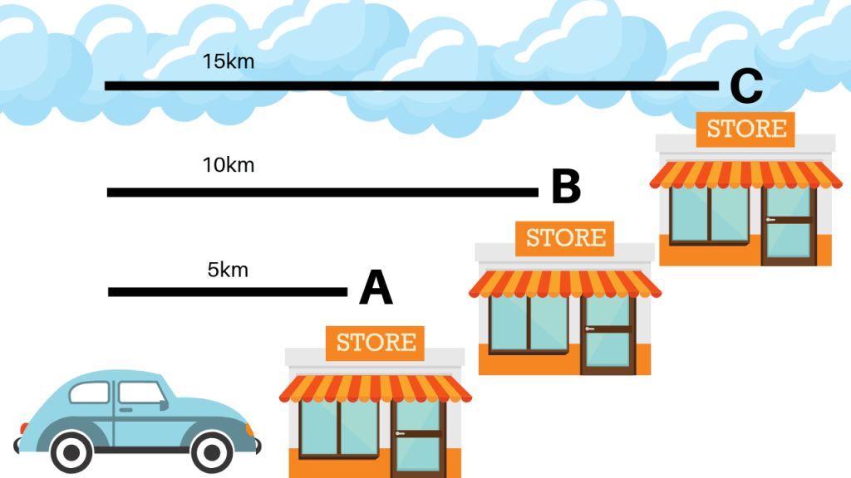
Algo - Arbitrage
Latency Arbitrage
Latency refer to the delay between your instructions and the time it takes for them to be executed. Latency Arbitrage derives its advantage by receiving and acting on market information faster than other market participants and “front-run” their orders. It is popular in US (not in HK) because US has many different trading venues (ECN - Electronic Communication Network)

Slide 98
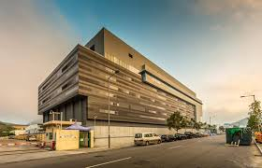
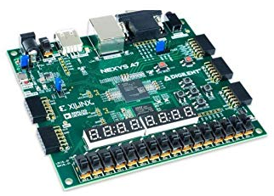
Algo - Arbitrage
For extreme speed and low latency, it requires expensive infrastructure and hardware
Co-location
Host the trading systems closer or at the exchange premise
receive market data and signal faster
increase the speed of transactions
HKEx Data Centre and Hosting Services
FPGA (Field-Programmable Gate Array)
Program the trading logic directly in the FPGA hardware
In Pursuit of Ultra-Low Latency: FPGA in High-Frequency Trading

Slide 99

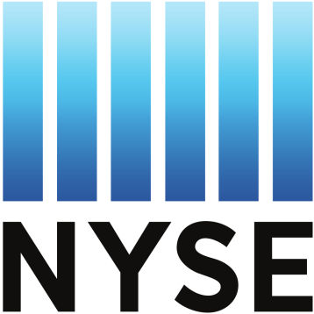
Algo - Arbitrage
Counter Measure by big company
Executing synchronised trades in multiple exchanges, consisting of atomic clocks meticulouly calibrated to vibrations of irradiated cesium atoms to sync orders to within a few billionths of a second (nanosecond). The smaller orders are sent to servers located as close to the exchanges as possible, along with instructions on the precise times that they should be executed. The co-located servers sync their transactions so that HFT firms won’t have enough time to identify an order on one exchange and then race to another to trade against it.
Renaissance Technologies Aims at HFT by Using Atomic Clock
Regulator
Latency arbitrage is unfair to retailers or smaller participants that do not have the resource to build sophistication trading infrastructure. The New York Stock Exchange (NYSE) has won approval to implement its proposed 350-microsecond delay on NYSE MKT which slow down the high-frequency traders and level the playing field.
NYSE gets speed bump approval from SEC

Slide 100
Exchange and Rules - Hours
HKEx Cash Equities Trading Hours
Open Auction | 9:00 | 9:15 |  | Order Input
 | 9:15 | 9:20 |  | Pre-order Matching
 | 9:20 | 9:28 |  | Order Matching
 | 9:28 | 9:30 |  | Blocking Period
Cont Trading | 9:30 | 12:00
Lunch break | 12:00 | 13:00
 | 12:30 | 13:00 |  | Afternoon Adjust
Cont Trading | 13:00 | 16:00
Closing Auction | 16:00 | 16:06 |  | Order Input
 | 16:06 | 16:08 |  | No-Cancel Period
 | 16:08 | 16:10 |  | Random Closing

Slide 101
Exchange and Rules - Auction
Open/Close auction
Open and Close price has significant meaning for benchmarking and mark-to-market
It is not desirable to have one trade to determine the open/close price (which is easier to manipulate)
Prevent too many orders at a single open/close time that may overload the trading systems; hence a few mins of auction period to spread out the transactions
Indicative price & volume (IEP & IEV in HK) is chosen that either maximize the execution quantity or notional
Can use random opening/closing time to prevent gaming

Slide 102

Exchange and Rules – HK Closing
HSBC incident in 2009 and suspension of closing auction
Re-introduce in 2016 with price range and random closing
(Note: auction market order seems unnecessary)
What Happened?
HSBC shares in the last seconds of the CAS on 9 March 2009, the indicative equilibrium price (IEP) of HSBC shares fell 10.8% from around $37 to $33
at-auction sell orders for a total of 5.4 million HSBC shares placed in the last seconds of the CAS and an at-auction limit sell order for 6,000 HSBC shares at $33 placed earlier by a retail investor

Slide 103
Exchange and Rules – Short Sell
Most markets cannot do naked short and need to have stock borrow arrangement
Short Sell Uptick rules to prevent pushing down the price
HK: short sale must be placed at or above the current best ask price. Exceptions apply for authorized market makers of HKSE listed options and index arbitrage desks of brokerages. Some stocks (mostly ETF are excluded as well) are exception of tick rule.
JP: orders can be placed at or above the last price if it is an uptick but can only be placed above the last traded price if it is a downtick. Open Auction, it's closing + 1 tick. Exceptions for hedging and arbitrage

Slide 104
Exchange and Rules - Trade
Trade type: the nature of the execution. Most importantly is to determine if it happens on-exchange or off-exchange (e.g. block crossing trade). HK example below:
Type | Description
D | Odd lot transaction
M | Manual or Special lot non-Direct Business transaction
P | Pre-open transaction (trade concluded before market open including that concluded but not recorded in the system before market close of the previous trading day)
U | Auction transaction
X | Manual or Special lot Direct Business transaction
Y | Automatch Direct Business transaction
"" | Automatch non-Direct Business transaction
* | Rejected/Cancelled transaction
Volume tracking Algo (e.g. POV) count which trade type?

Slide 105
Exchange and Rules - Lot & Tick
Lot Size: the order quantity has to be in the multiple of lot size. Less than one lot is called odd lot. In HK, the lot size varies from stock to stock. In SG, it’s always 100
Tick Size: the smallest unit of price increment or decrement. In US, after Decimalization, all the tick size is 0.01 and also the lot size is 1 and hence made programming Algo system easier.
Min | Max | Tick Size
0 | 0.01 | 0
0.01 | 0.25 | 0.001
0.25 | 0.5 | 0.005
0.5 | 10 | 0.01
10 | 20 | 0.02
20 | 100 | 0.05
100 | 200 | 0.1
200 | 500 | 0.2
500 | 1000 | 0.5
1000 | 2000 | 1
2000 | 5000 | 2
5000 | 9995 | 5
HK Tick Size table

Slide 106
Exchange and Rules – Price Range
Price range: the max and min trading price of a stock
Market
Hong Kong | Quotation Rule: Order price not away more than 24 spreads from nomimal price in Cont Trading; +/- 24 in Auction
Taiwan | 10% from close
China | 10% from close
Singapore | 10% from close
Korea | 15% from close
HK uses dynamic price range which is the most difficult to program and monitor

Slide 107

Exchange and Rules - Volatility
Volatility Control Mechanism (VCM): prevent or control the extreme volatility and provide cool down period: https://www.hkex.com.hk/vcm/en/index.htm

Slide 108
Exchange and Rules – HK
https://www.hkex.com.hk/Services/Trading/Securities/Overview/Trading-Mechanism?sc_lang=en
Order Type: At-auction, At-auction Limit, Enhanced Limit, Special Enhanced Limit (Fill-And-Kill)
(Enhanced Limit only on order entry. Once it is in order book, it becomes limit order. Price amend to a wrong price could result in order rejection)
Nominal Price & Quotation Rules, Closing Price adjustment
Non-CAS closing price calculation (Throttle Management)
Shows Broker ID
China Connect
Notes:
TW IT people write game not finance

Slide 109
Exchange and Rules - Highlights
Market
Taiwan | Mini-batch at every 20s at continuous trading session No market data update during auctions
Japan | Use Special Indication to avoid big price move SQ Days – Future Price Calculation affect trading behavior Stock doesn't open if (auction) market orders not fully filled
Australia | Stage opening based on symbol names Central Point Order (Peg-to-mid)
Korea | Entrance Exam day delay opening hour Trading Systems located in KR (send with IP address)
Taiwan & Korea: ID market (show the investor); some stocks (like telco and media companies) subject to foreign holding limit
Notes:
TW IT people write game not finance

Slide 110
Exchange and Rules - Highlights
Market
Singapore | IPO start at half day Force key Tick size based on currency Buy-in, Unit Share market
India | Cannot determine on or off exchange trade type BSE and NSE parallel trading (SOR logic) Closing Price by last 30-min VWAP
Thailand | Local/Foreign board vs NVDR (Non-Voting Depository Receipts) Publish Order (exchange Iceberg order)
Indonesia | Friday trading hours are different due to religious reason
Notes:
TW IT people write game not finance

Slide 111
Dark Pool and Internal Crossing
Dark Pool & Internal Cross: the order execution outside the main exchange
dark means the price is not visible to human traders
save commission and execute faster
without signal the outsider
can execute at mid-price or any price in between bid/ask (save transaction cost to both buy or sell side)
Alternative Trading Venues: also called “Lit” venue (contrast to dark). Another execution venue outside main exchange but the orders can be seen
Smart order routing: logic to decide which venues (dark pool, lit venue, main exchange) to place the orders

Slide 112
Dark Pool and Internal Crossing
Dark Pool related logic usually has
anti-gaming: “min execute quantity” to prevent pinging dark pool with small order
peg-to-mid order type
give preference to certain (client) flow
only match with certain type of flow
Algo related enhancements
Stealth: can rest all quantity in dark pool as the order is not visible to human
Benchmark Algos: can place certain portion into the dark pool with peg-to-mid order type to save spread costs

Slide 113
Dark Pool and Internal Crossing
HSBC fined $6 million by Hong Kong watchdog over dark pool programme
Existing clients would be given the option of "opting in". HSBC proposed to launch the Crossing Service to its retail clients, and that an "opt out" approach would be adopted, whereby clients would effectively be assumed to consent to their trades being matched and crossed on the Crossing Service unless they took the initiative to notify HSBC otherwise.
Hong Kong watchdog fines JPMorgan for dark pool, control failures
mistakenly routed principal orders into its off-exchange dark pool trading platform, despite advising the SFC the pool only matched client trades.
Hong Kong's SFC bans retail investors from dark pool trading platforms
Only institutional investors such as fund managers or professional, experienced investors with portfolios of at least HK$8 million will be allowed to trade on the 16 dark pools operating in the city
Notes:
One change: remove the explicit Dark Pool Algo from the UI (in fact, use params can do)

Slide 114
Error & Risk Control
SFC reprimands and fines Sun Hung Kai Investment Services Limited
Fined $1.5 million for internal control failures relating to an erroneous buy order for two billion shares of China Life. On 8 September 2011, an account executive of SHKIS received an order from a client to buy 25,000 shares of China Life at $18.82. The account executive, however, mistakenly inputted “2,500,018,000” shares as the order quantity. The dealing system of SHKIS automatically split the erroneous order into 834 smaller orders which were then sent to the market
SFC reprimands and fines Credit Suisse (Hong Kong) Limited
Fined a total of $39.3 million for regulatory breaches, including failures in segregating client securities, reporting direct business transactions, complying with short selling requirements
SFC reprimands and fines Interactive Brokers
Fined $4.5 million for its execution of market orders using electronic and algorithmic trading systems. The SFC’s disciplinary action followed two market disruption incidents in 2015 and 2016 where the share prices of Hong Kong-listed O-Net Communications (Group) Limited and AAG Energy Holdings Limited were ramped up by 48.7 per cent and 126 per cent, respectively, in less than two minutes.

Slide 115
Error & Risk Control
Fat Finger Limit (FFL): set the max quantity & notional, price deviation to catch unrealistic inputs due to extreme market conditions, human typos or erroneous setup
Transactions limit: no. of repeated cancel/resend (may be seen as flashing order for false signal); limit the no. of trans per minute
Price Impact: snap a starting reference price and set the Algo trading price range (usually in steps of 3%, 5%, 10% etc.)
Prevent Own Execution: For certain Algos (Market Making), Buy/Sell price can never been crossed as it will lead to executions. This may be deemed as creating fake transactions
Order Monitoring: order overfill; order pending for too long (e.g. connection lost)

Slide 116
Error & Risk Control
Market data check: During continuous trading session, bid ask cannot be crossed
Emergency Control: A “panic” button to cancel / pause all orders in case of emergency. Pause order when disconnect from market data (or stale market data) or downstream systems (such as losing exchange connectivity).
Environment Segregation: Development, QA and production environment needs to be separated properly (send QA order to production is the major disaster)
Others (usually outside Algo system)
Position (inventory) Check: check if the client has enough position to do sell order
Credit Check: has enough margin or money to buy the stocks
Flagging: tag client vs house orders correctly

Slide 117
Develop Automated Trading System
Static Reference data
ADV (Average Daily Volume)
Average Bid/Ask (Queue) size
Average Spread
Historical volume profile
Instrument reference data (such as lot size, dividend, interest rate yield curve, volatility curve, repurchasing rate, contract date, expiry, and price multiplier)
Exchange rules: tick size, trading hours, price range etc.
Daily check on the data correctness
Number of rows comparing to last trading day
The values difference should be smaller than certain %

Slide 118
Develop Automated Trading System
Real market data time feed
Market data adaptor for information vendors (such as Reuters, Interactive Broker)
Bid/ask price and size
Auction indicative price (e.g. IEP, IEV)
Level 2 or Market depth
Trade size and volume, accumulate volume, turnover
Reuters (popularly used real-time feed for trading systems)
Advantage: provide uniform access to many markets (Bloomberg is terminal based which is more human-oriented)
Closing Run: the time to update the closing Price
Speed: provide consolidate feed which the data is aggregated and distributed from the data center (Singapore Hub for Asia) which is slower than the Exchange Direct Feed. (the fastest market data is the co-located data feed)

Slide 119
Develop Automated Trading System
Connectivity
Upstream – support FIX connection to receive orders or manual input from the trading GUI. FIX message (tag=value pair) example below
8=FIX.4.4|9=126|35=A|49=theBroker.12345|56=CSERVER|34=1|52=20170117- 08:03:04|57=TRADE|50=any_string|98=0|108=30|141=Y|553=12345|554=passw0rd!|10=131
Downstream – adaptor to connect OMS (Order Management System), broker (IB) or exchange gateway
Trading signals – used to publish the trading signals and it’s generally separated from the trading system
Others - connection to the position and risk management systems

Slide 120
Develop Automated Trading System
Order Management
Parent order – validate Algo and parameters, handle amendments (price, quantity, parameters, Algo to Algo). Amend examples:
Amend price to more aggressive or passive
Increase or decrease quantity
Increase completed order quantity up
Increase POV%
VWAP -> POV Algo
Exchange order
(Pending) new, (Pending) accept, (Pending) cancel, (Pending) amend
Fills (partial and fully fill)
DFD (Done For Day), Reject

Slide 121
Develop Automated Trading System
Event Handling
Market data tick
Timer
Order events
Market signals
Algo events
Strategy rules
The core logic of the Algo itself
Market rules
Implement the exchange rules for each market

Slide 122

Develop Automated Trading System
Performance
Reduce market data ticks processing power consumption: Tick Combine (e.g. merge the execution, discard the stale bid/ask)
Setup multiple instances with symbol range striping in each instance. Hence, each trading instance only listen and process certain symbol ranges of orders. Alternatively stripe by strategy such that each instance only process certain strategies (such as MOC).

Slide 123
Develop Automated Trading System
Testing
Unit Test: test induvial functions and calculations
Automated Testing: test all the defined scenario for correctness during continuous development (code check-in)
Back testing: algo strategy performance (for VWAP performance bps)
Load testing: test the capacity to handle the no. of orders
Connectivity test: test the connection between upstream and downstream systems
Logging
Debug & Audit trail
Database
Order history
Transaction Cost Analysis

Slide 124

Develop Automated Trading System
Trading GUI
Control: stop/pause/resume orders, panic button, dynamically modify Algo (internal) parameters, input new order, split new child orders, cancel or amend orders.

Slide 125

Develop Automated Trading System
Trading GUI
Monitoring: execution progress, strategy performance, market data

Slide 126
Develop Automated Trading System
Development Languages
Java, most popular these days
C#
C++
Why Java most popular
Large developers pools , communities and APIs
Acceptable latency: Algo trading is in millisecond range (HFT requires lower latency)
Relatively easy to code (compare to C++)
Challenges of Java
Garbage collection
JVM settings

Slide 127

Develop Automated Trading System
CyanSpring - http://www.cyanspring.com
Notes:
Open the Web site

Slide 128

Develop Automated Trading System
Quantopian - https://www.quantopian.com/home

